Slide 1
Easy Go
By CODEMENDORS

Slide 2
Overview
Easy go is an application which automates the navigation.
Uses machine learning OCR.
We have developed Android app Website

Slide 3
Understanding the problems
01
Currently there is no mechanism in any maps application where we can upload pictures and takes its text as an output.
02
Implementing the revenue model into Maps.
03
Make navigation more easy..

Slide 4



Target audience
We are planning to launch it on android as well as on Internet so that we can cover as much as audience as possible
Application is very easy to access
Our target audience will be all the persons who are using the maps for navigating ..

Slide 5
Technology Stack
Persona 01
Python
Machine learning
Android
Web development
45%
83%
42%
77%
Andorid app
Machine learning
Website
Python

Slide 6
Cycle diagram
04
Data
Show Result
Take a picture containing address
Getting the shortest path posssible .
01
03
Machine learning
Get feedback
OCR process
Getting the directions.
02

Slide 7
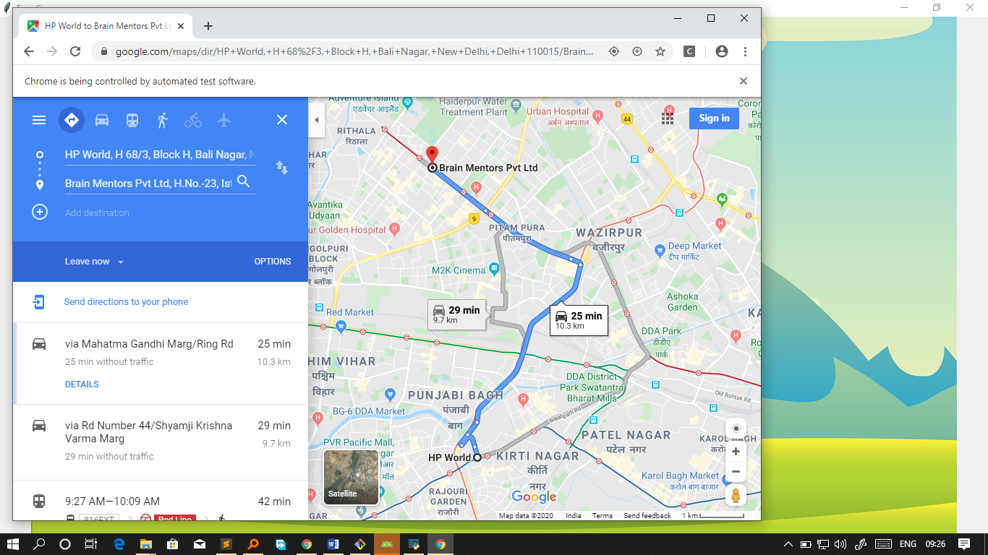

Spotlight on desktop
Screenshot of our application.

Slide 8

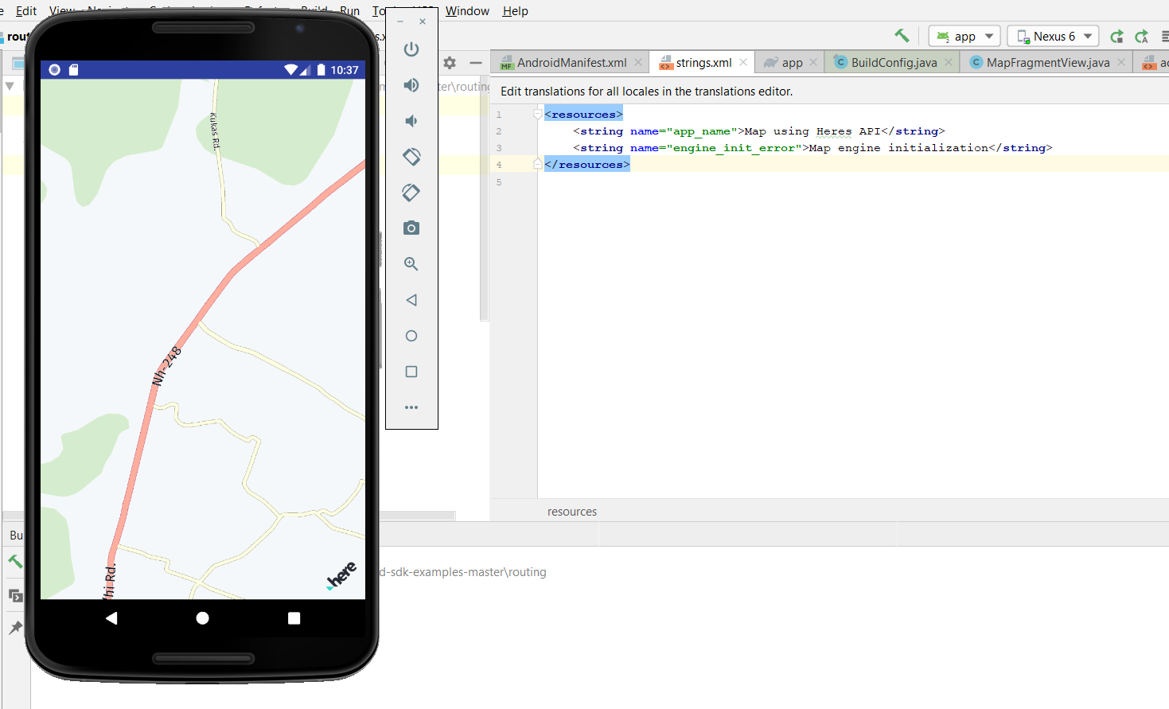
Android Application

Slide 9
Thank you!
By Team Codemendors

